Slide 1
GOVERNMENT OF TELANGANA Rural Water Supply & Sanitation Department State level workshop on Heatwave preparedness 2018

Slide 2
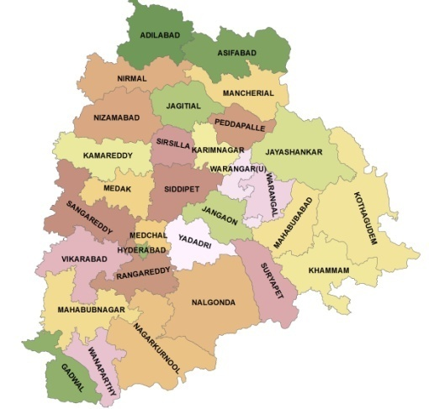
TELANGANA- At a Glance (Semi-arid zone)
Districts | 30
Mandals | 438
Gram Panchayats | 8695
Villages | 10098
Rural Habitations | 24562
SC Dominated Habitations | 1710
ST Dominated Habitations | 9739
Total Population (Lakhs) | 350.04
Rural Population (Lakhs) | 226.41
SC Population(Lakhs) | 42.23
ST Population (Lakhs) | 29.80
2
Notes:
Geo-Physical Data

Slide 3
Rural Water Supply
Rural Water Supply and Sanitation Department is the nodal agency in the State for providing drinking water and sanitation facilities in rural areas. Drinking water facilities are being provided by various types of schemes such as bore wells with hand pumps, PWS Schemes, CPWS Schemes etc.,.

Slide 4
Basic Information (as on 23.03.2018)
Hand pumps fitted to bore wells : 1,40,806
PWS/MPWS Schemes : 29,752
CPWS Schemes : 167
Water Testing Laboratories(HQ-1,Div-19, SD-56) : 76
Status of habitations as on 23.03.2018
Fully Covered Habitations (FC) (>100% pop. coverage) : 8787
Partially Covered Habitations(PC) (0-100% pop. Coverage) : 14383
Quality Affected Habitations (QA)
(Fl-967,Salinity-192,Iron-45,Nitrate-138) : 1392
Total : 24562

Slide 5
Drought Mitigation Strategy Adopted:
Crash Program is taken up during Feb’18 - March’18.
Drought monitoring cells at State level, Circle level and District levels are constituted to receive the complaints on drinking water problems from 8 Am to 8 PM and redress them with special drive.
The contingency plan for each District is prepared at district level. The priority for provision of drinking water is as follows:
Steps taken for providing drinking water bulk supply to the vulnerable habitations on priority through Mission Bhagiratha project.
Steps taken for completion of all ongoing piped water supply schemes, in the drought affected villages, on war foot basis.

Slide 6
Piped water supply schemes or borewells already constructed in any of the villages which are non-functional are made functional by undertaking necessary repairs or renovation.
If any of the above mentioned measures are not feasible, following temporary emergent measures are taken up with central Government assistance under CRF in the following order of priority.
Flushing & deepening of borewells, Desilting of existing wells, adding extra lengths of raisers and connecting shaft in hand pumps to reach the lowered ground water table.

Slide 7
Requisitioning Private Wells when no other mode of supply is possible by due compensation.
When no other sources is feasible, transporting water through tankers (up to 15 LPCD) to places where there is no water over a reasonable distance of not less than 1.5 km. to 2 kms.
Monitoring of the water scarce habs is being done on daily basis.

Slide 8
Since formation of Telangana state, the fund allocation and expenditures towards drought mitigation measures taken up under CRF is as follows:
Status of CRF grant in Telangana State
Rs. In crores
Sl.No | Year | Vulnerable habs taken up | CRF
 |  |  | Hiring of sources (Habs) | Transportation (Habs) | Expenditure
1 | Summer 2014 | 1087 | 946 | 141 | 1.25
2 | Summer 2015 | 2667 | 1709 | 958 | 63.07
3 | Summer 2016 | 10807 | 5924 | 4883 | 158.9
4 | Summer 2017 | 1831 | 1790 | 842 | 14.91

Slide 9
Present situation of drinking water supply
Daily report on drinking water situation Date: 22.03.2018
Sl.No | District | No. of habitations affected | Transportation |  |  |  | Hiring of Private Sources
 |  |  | No. Of Habs. | Population Served | No. of trips | Quantity | No. Of Habs. | No. Of Sources | Population Served
1 | WANAPARTHY | 3 | 3 | 2826 | 11 | 55 | 0 | 0 | 0
2 | NAGARKURNOOL | 8 | 8 | 7578 | 25 | 125 | 0 | 0 | 0
3 | NALGONDA | 59 | 33 | 26888 | 116 | 560 | 26 | 36 | 18243
4 | BHUPALAPALLY | 35 | 0 | 0 | 0 | 0 | 35 | 40 | 25121
Total: |  | 105 | 44 | 37292 | 152 | 740 | 61 | 76 | 43364

Slide 10
Since formation of Telangana state, the fund allocation and expenditures under Non CRF is as follows:
Status of Non-CRF grant in Telangana State
Rs. In crores
Sl.No | Year | No. of Vulnerable habs | Non CRF(Plan & Non plan)
 |  |  | Expenditure
1 | Summer 2014 | 248 | 7.78
2 | Summer 2015 | 4719 | 175.28
3 | Summer 2016 | 5962 | 212.34
4 | Summer 2017 | 994 | 57.45
 |  | Total | 452.85

Slide 11
Other drought monitoring Activities
Chief Engineers and Senior officers are allotted to all the 30 districts for close monitoring of the situation and to guide the district authority.
Special drive is taken up to complete Mission Bhagiratha program, so that water can be released to solve the drinking water problem in vulnerable habitations.
The drought is managed keeping in view the general guidelines, issued from time to time and minimum water supply levels of 15 lpcd are ensured.
All officers are touring and monitoring the situation to mitigate the drought. Especially taking care of the remote habitations where people have no proper access to voice their needs.

Slide 12
Permanent measures:
In order to tackle the drought on a permanent basis, the Government has taken up flagship programme namely “Mission Bhagiratha” to provide safe, sustainable, adequate and treated drinking water to all the households through tap connections in the entire state of Telangana at 100 LPCD to the rural habitations, 135 LPCD for municipalities and nagarapalikas, and 150 LPCD for Municipal corporations, with surface water from the Krishna and Godavari rivers and major reservoirs fed by these rivers.

Slide 13
The Project outlay is Rs. 43,791 Cr. The project is divided into 26 segments based on the topography, commandability, proximity and ease of connectivity from various dependable sources and so far 6067 habitations out of 24225 rural habitations and 20 ULBs are covered with bulk water supply and the remaining habitations are planned to be completed by 2018 resulting in 100% water supply even during drought situations in Telangana by 2018.

